Slide 1
Predicting resignation rates in the ICT industry and trend analysis for ICT higher education intakes
Muhammad Iylia
P7474841
NSDDA1/CE/2220/4

Slide 2
Datasets
Job Vacancy Rates
Recruitment Rates
Resignation Rates
Paid Overtime Hours
Total Paid Hours
Incidence of Retrenchment
Polytechnic Intake
University Intake

Slide 3
Datasets
Filtered to Information, Communications and Technology industry data
Data with quarter column was split into year and quarter columns using pd.str.split()
Data was merged using inner join by year and/or quarter columns using pd.join()
‘-’ values were converted to 0

Slide 4
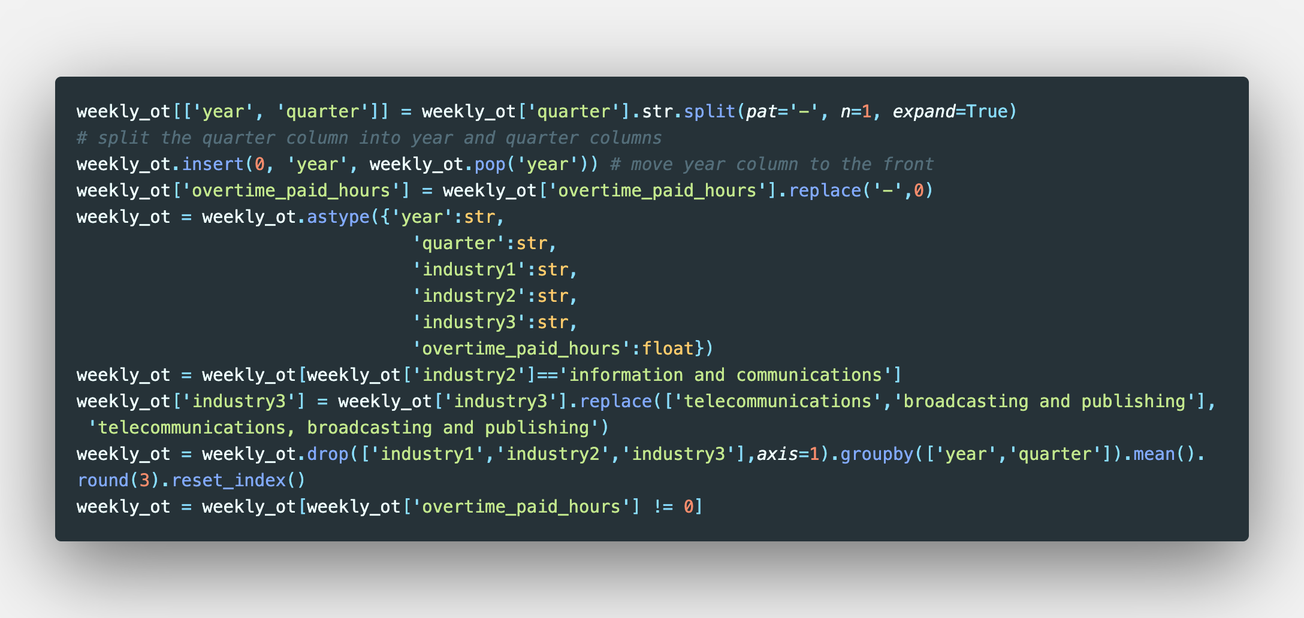
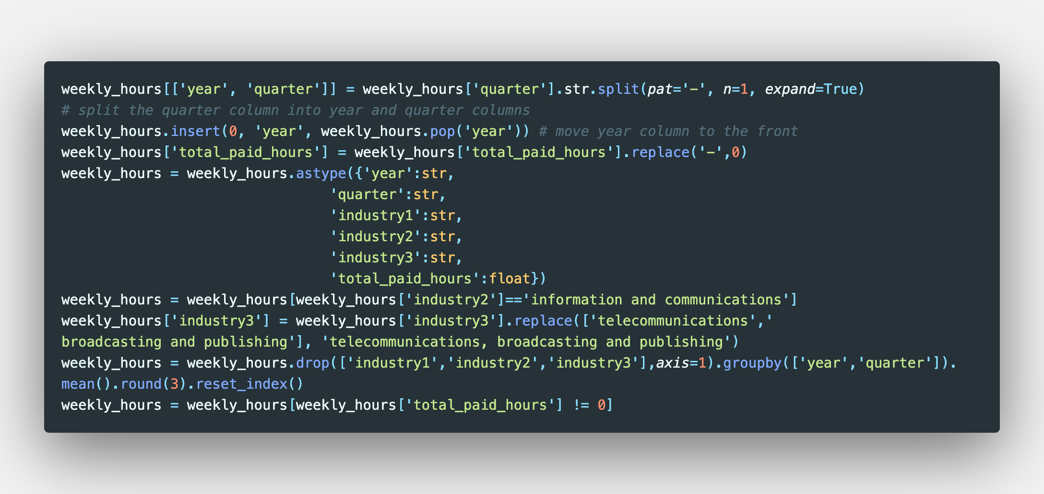
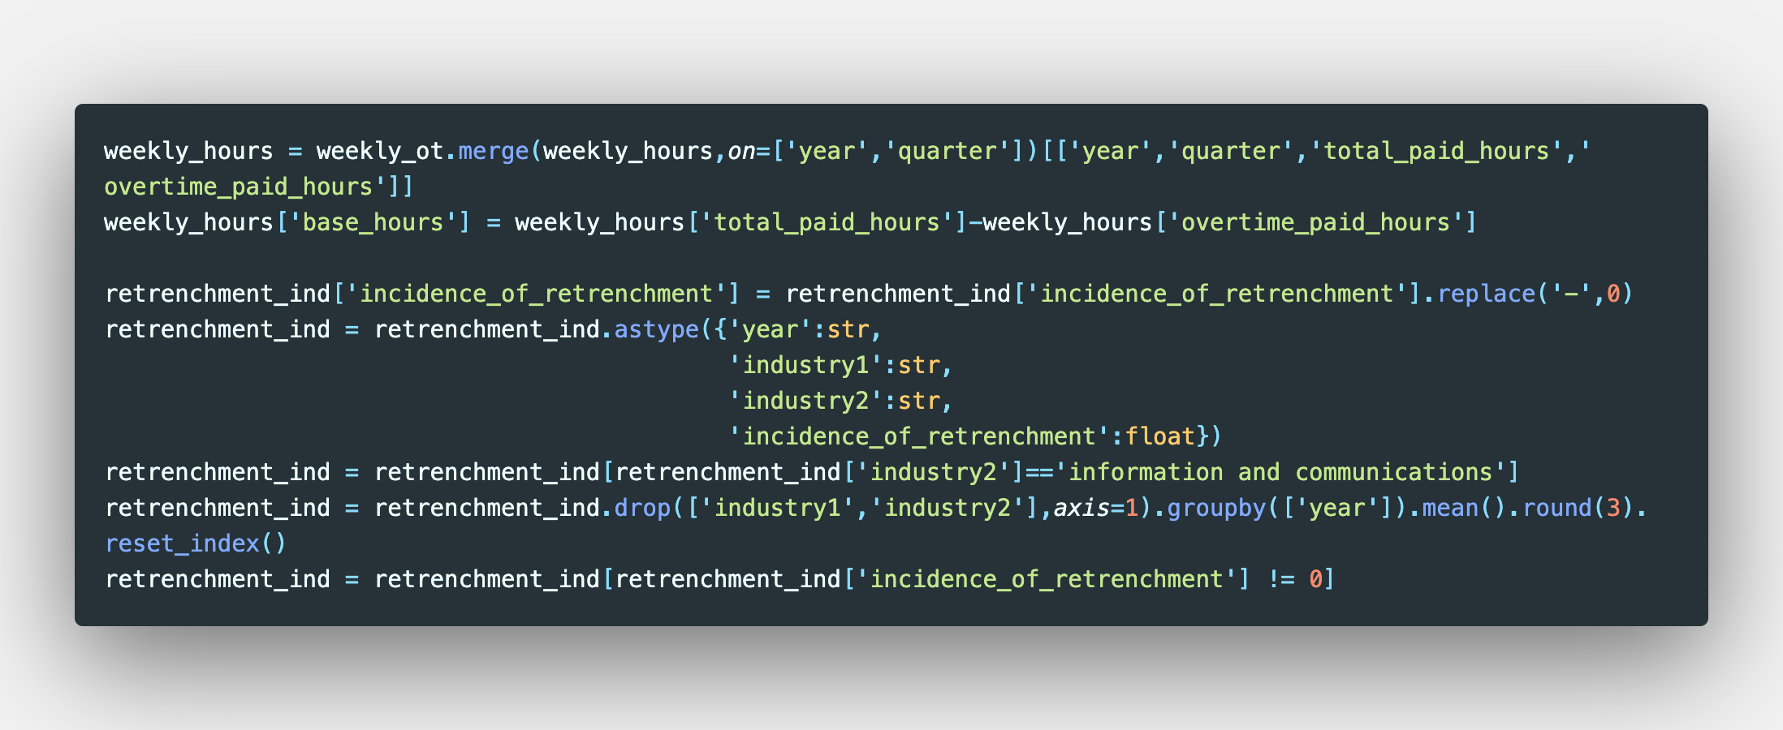
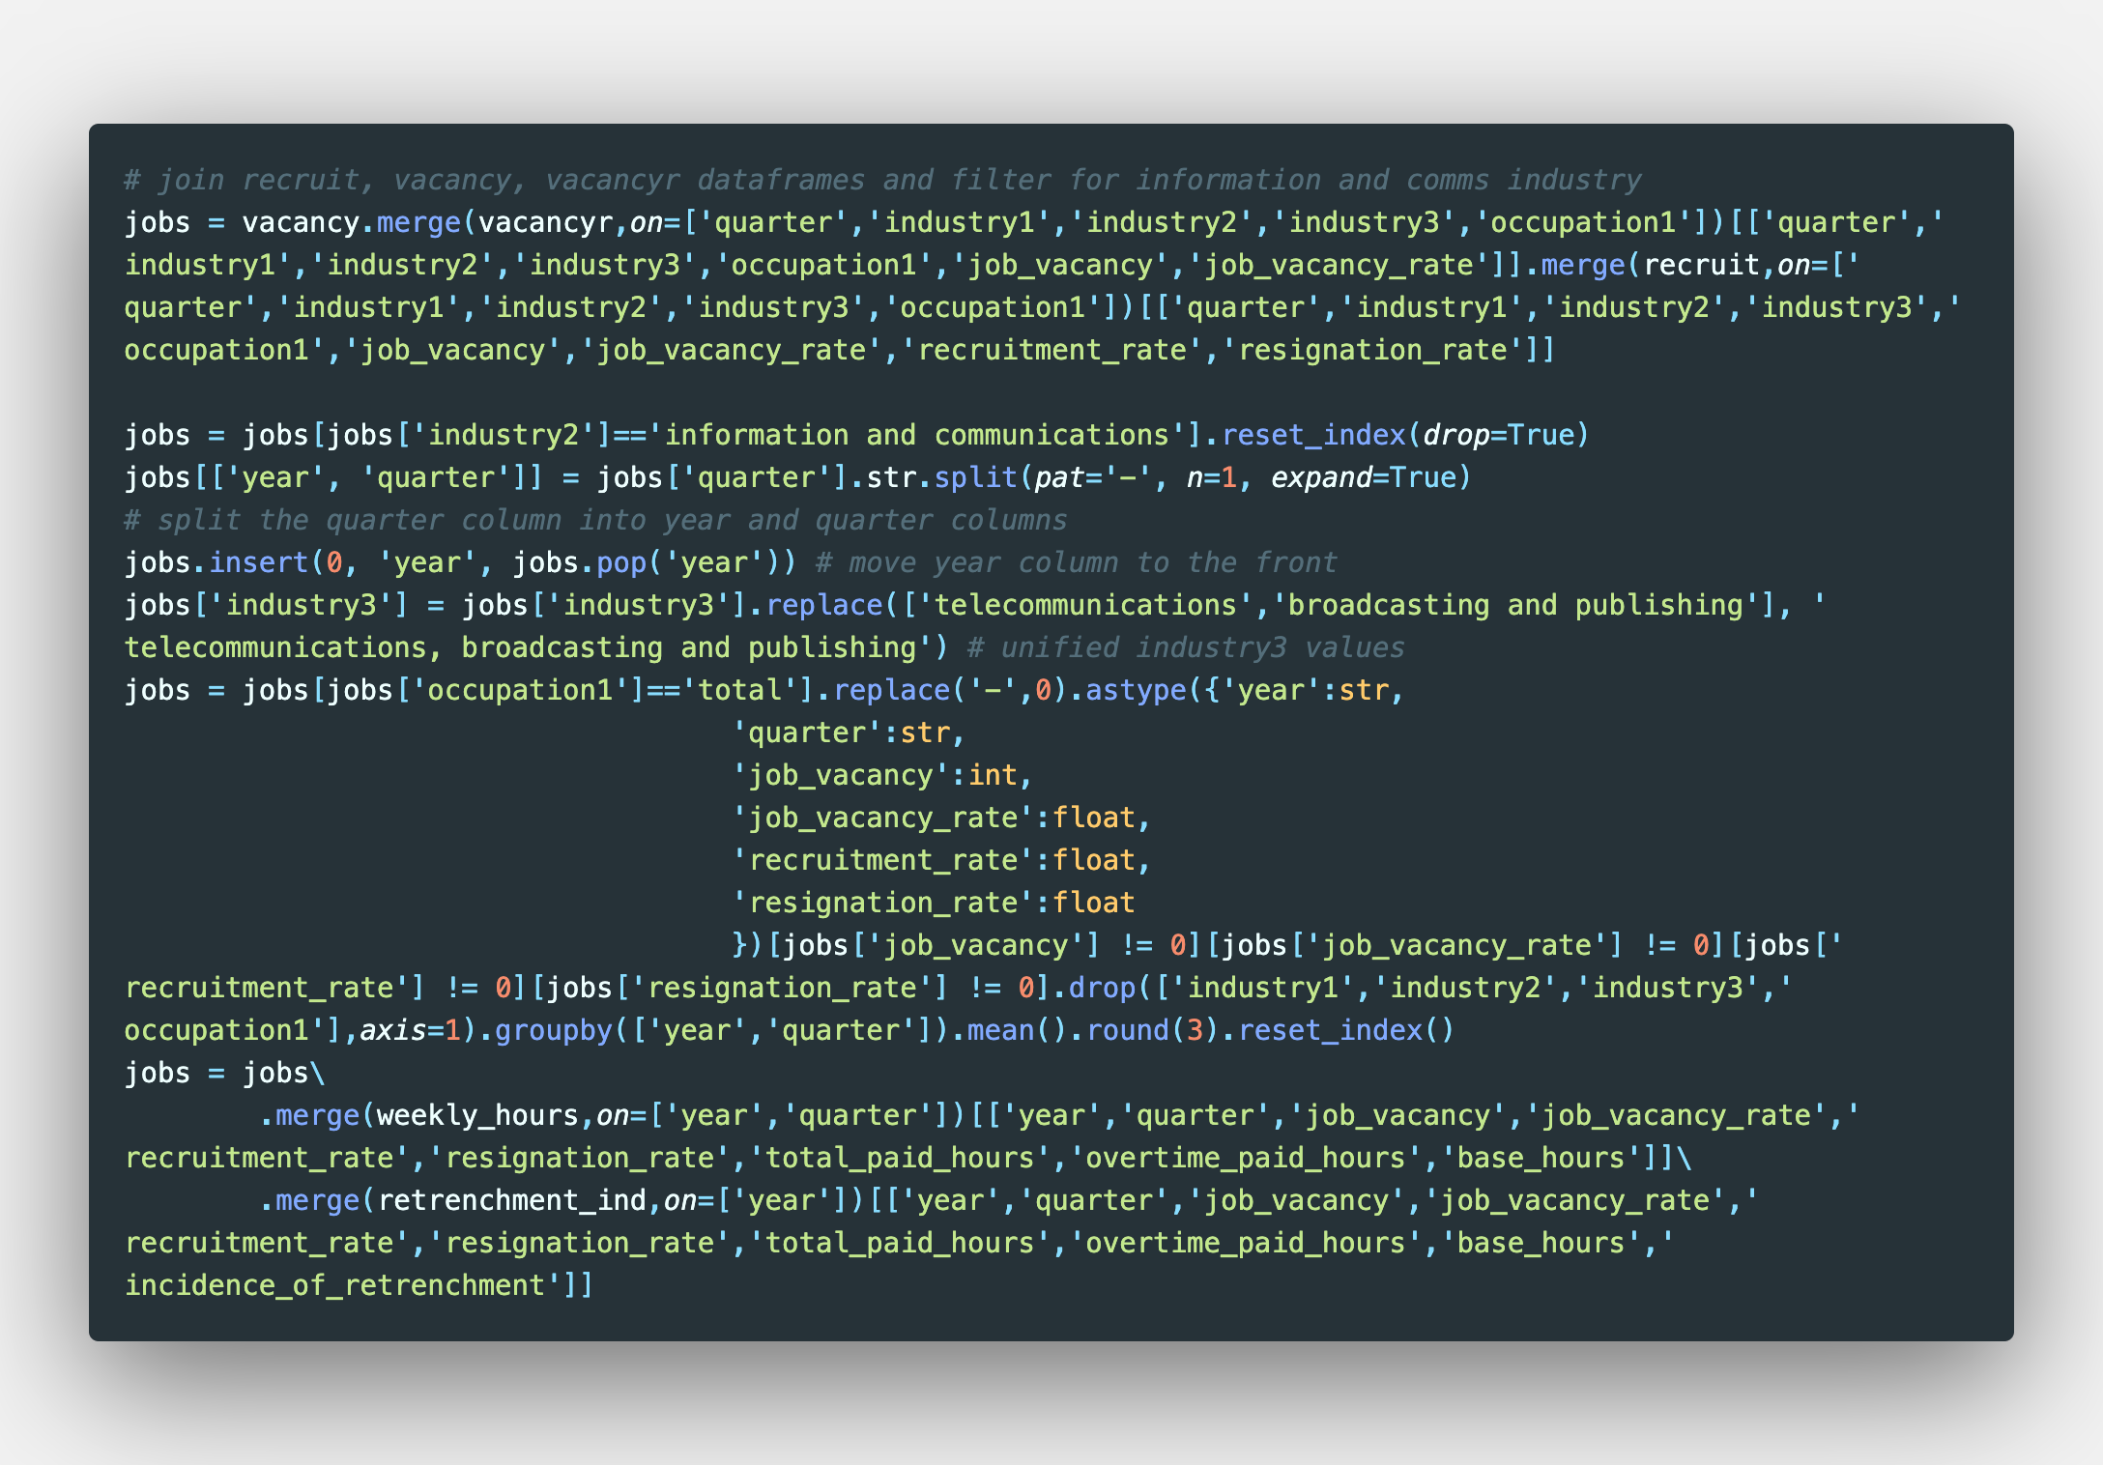
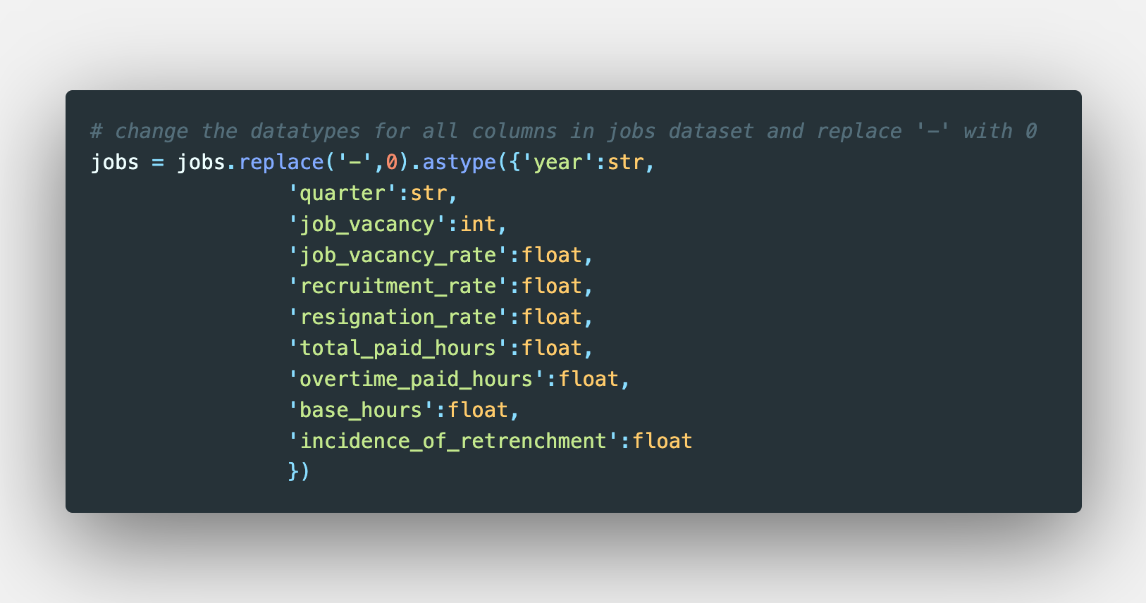
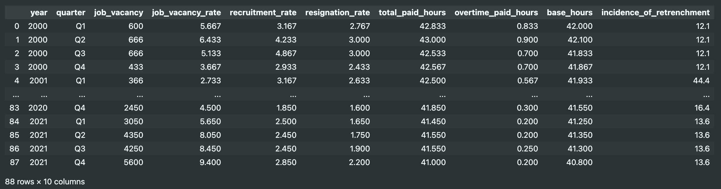
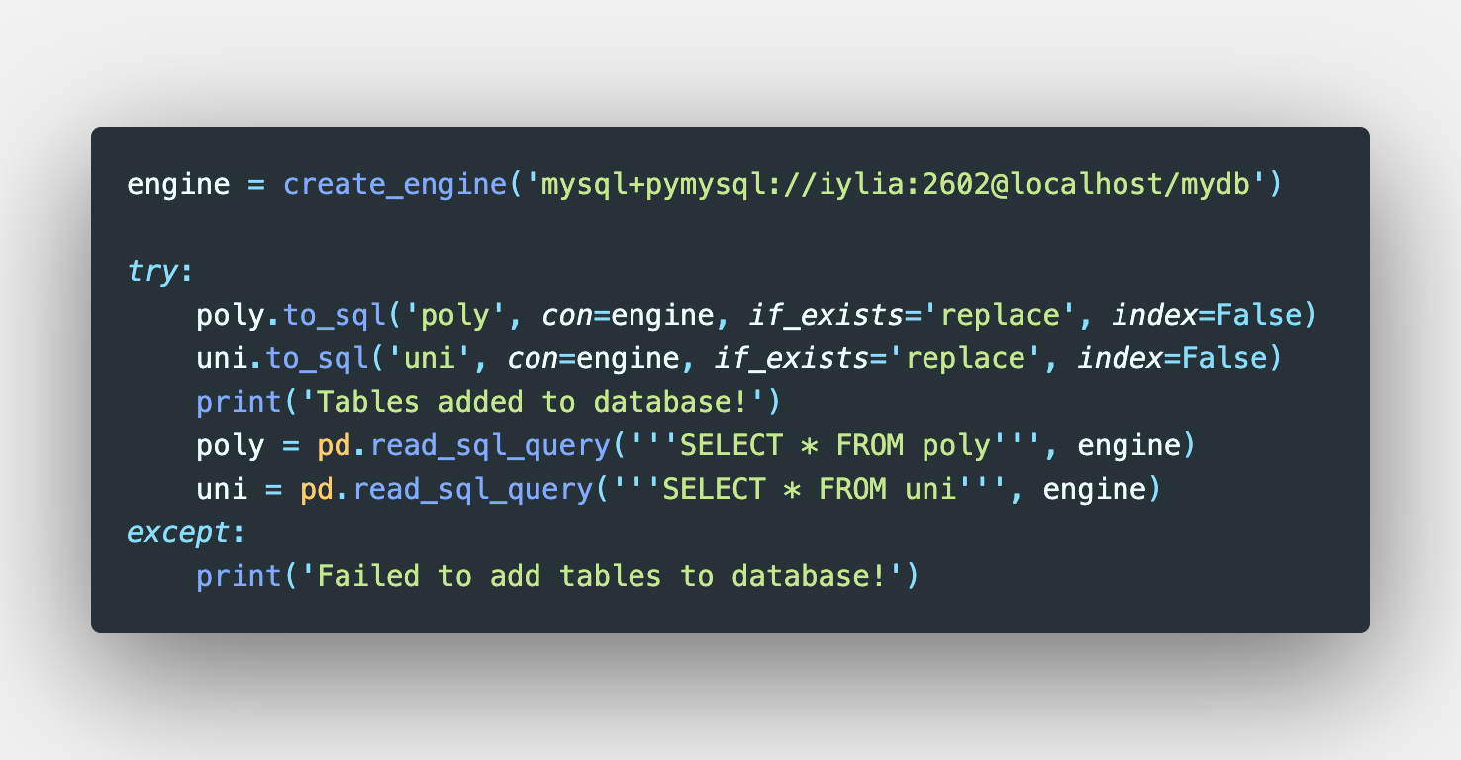
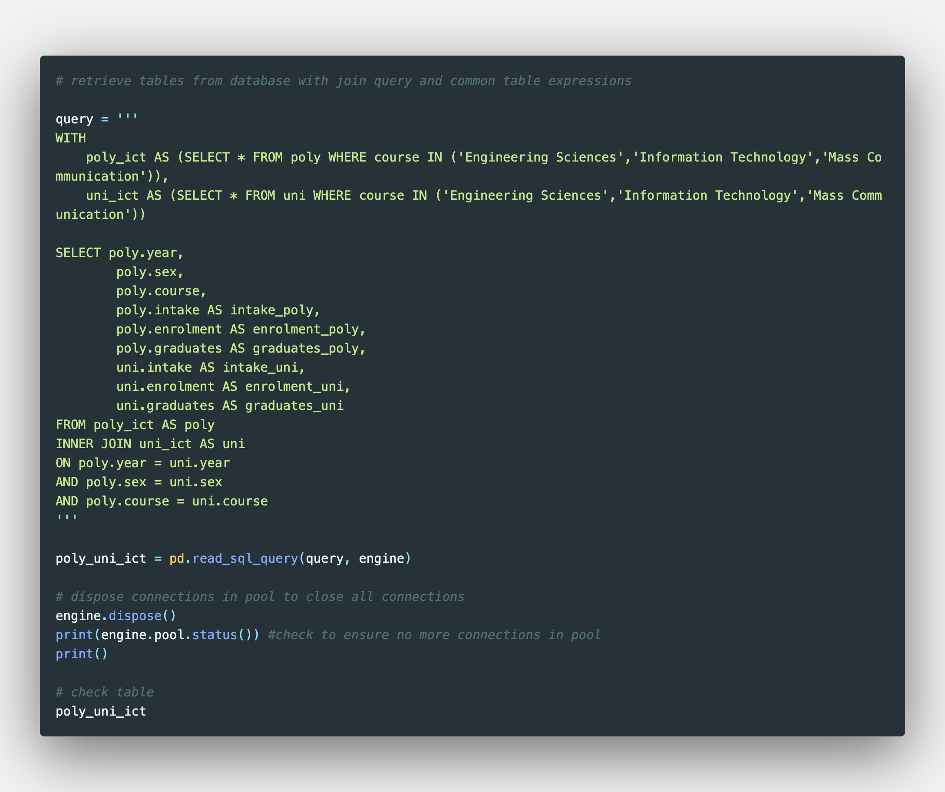
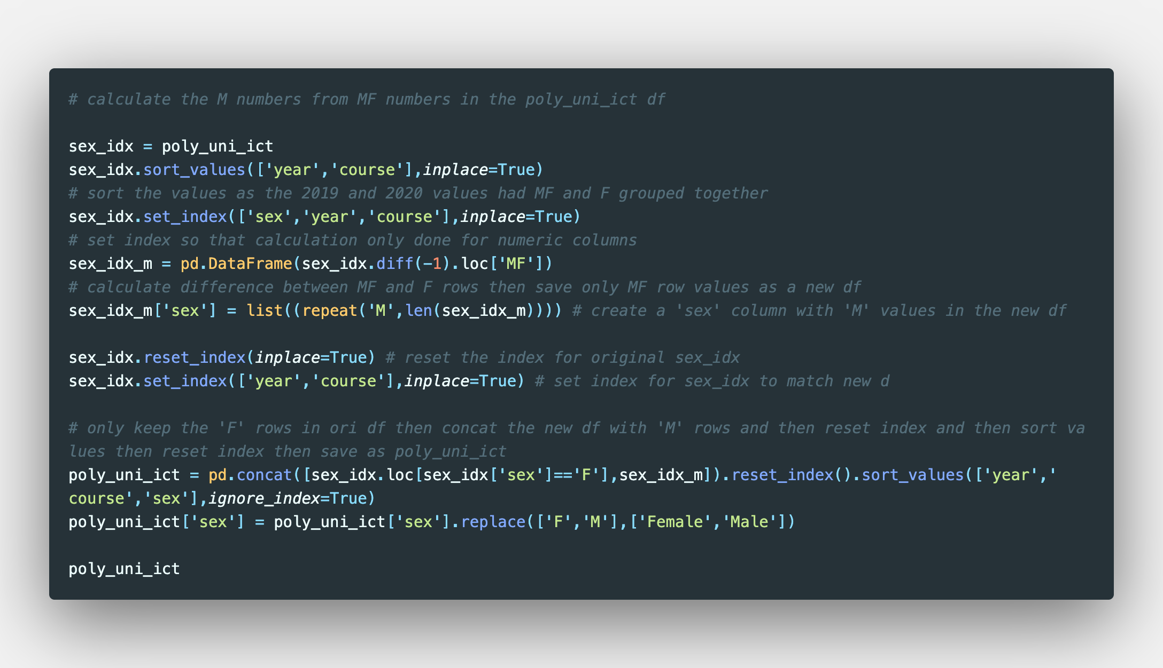
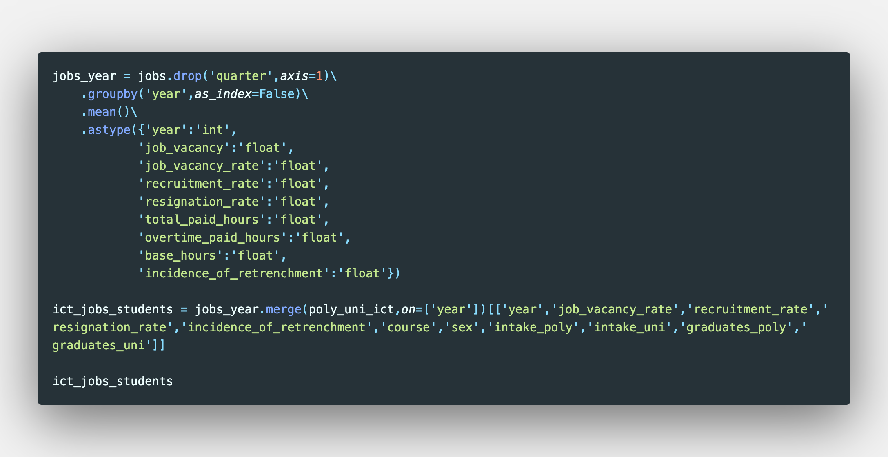
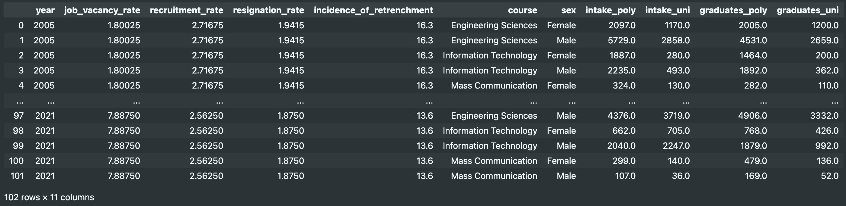
Datasets

Slide 5
Datasets

Slide 6
Datasets

Slide 7
Datasets

Slide 8
Datasets

Slide 9
Datasets

Slide 10
Datasets
Used sqlalchemy library to create tables in mysql database

Slide 11
Datasets
Used sqlalchemy library and SQL query to retrieve data from tables in mysql database

Slide 12
Datasets

Slide 13
Datasets

Slide 14
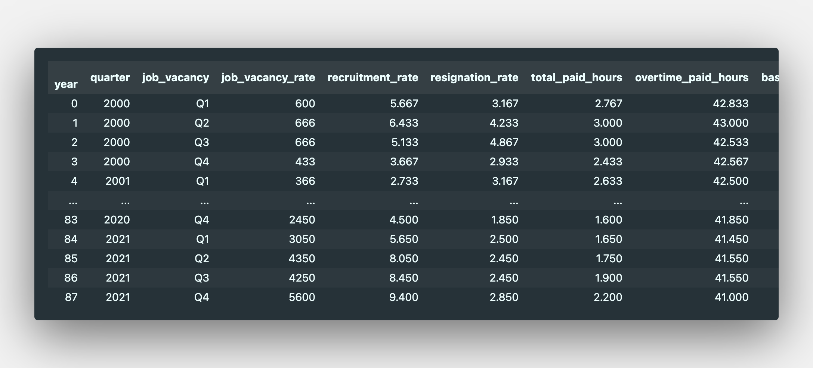
Datasets

Slide 15
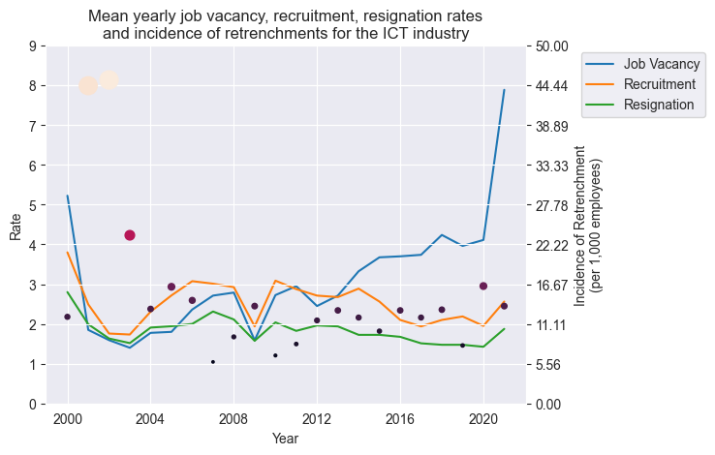
Mean yearly jobs data in the ICT industry
Incidences of retrenchments were seen to follow cyclical economic patterns
Post-crisis recovery also saw periods of increased vacancies with relatively stable recruitment and resignation rates

Slide 16
Tests of normality
Komolgorov-Smirnov test for samples larger than 50
Histogram plot
Q-Q plot
Variables of interest:
Job vacancy rate
Recruitment rate
Resignation rate

Slide 17
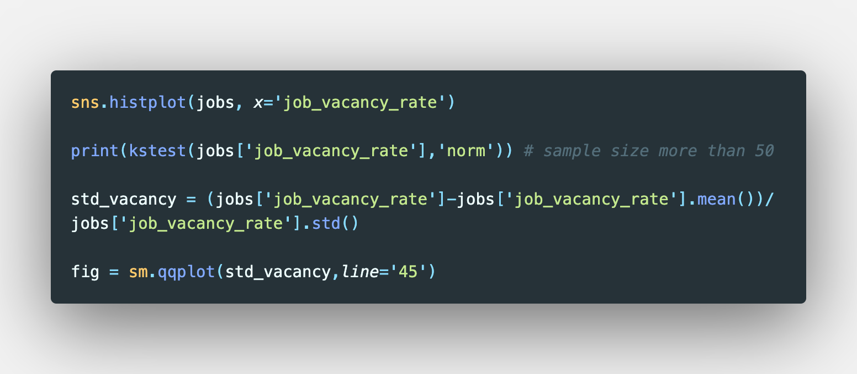
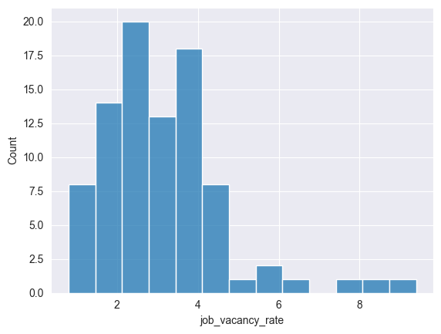
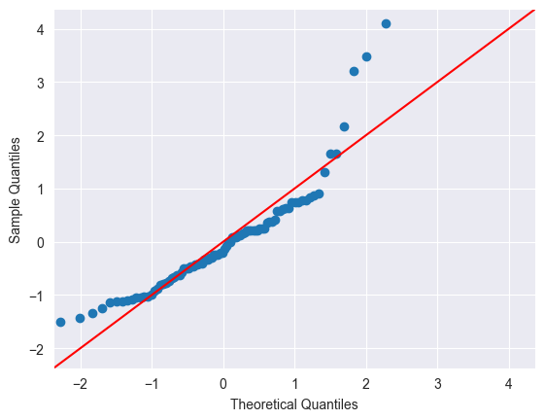
Job Vacancy Rate
Komolgorov-Smirnov Test (𝛼 = 0.05):
Statistic = 0.8687
p-value = 6.17
The data is non-normal based on the histogram distribution and Q-Q plots, despite rejecting the null hypothesis in the K-S test.

Slide 18
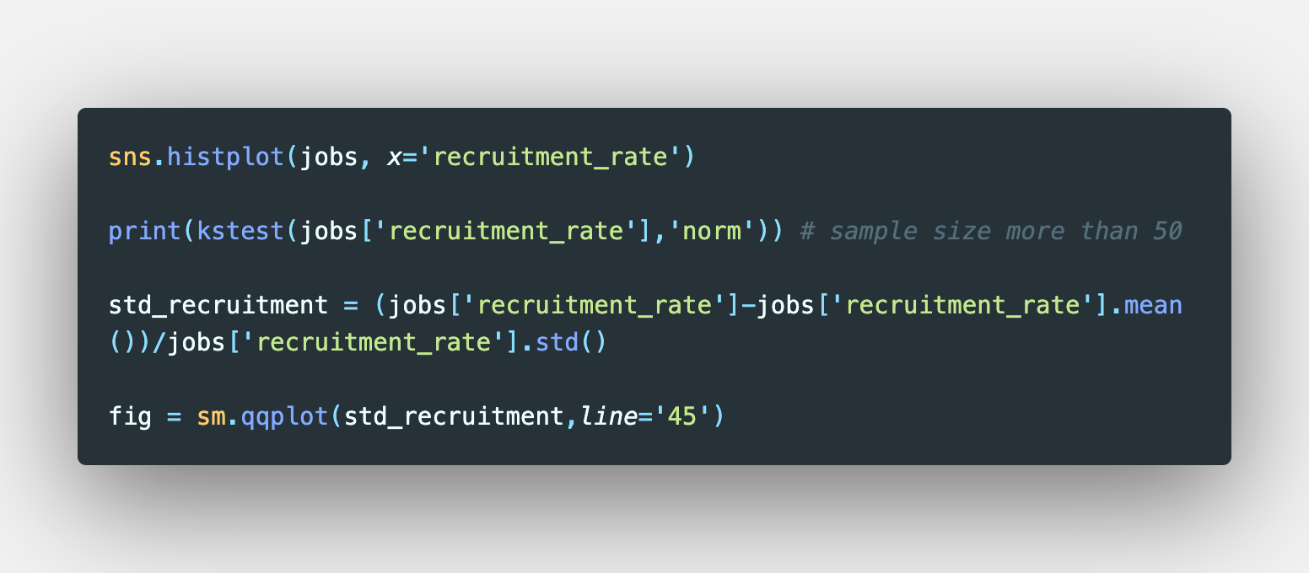
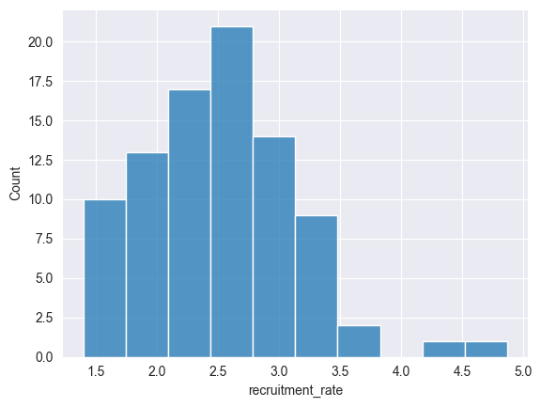
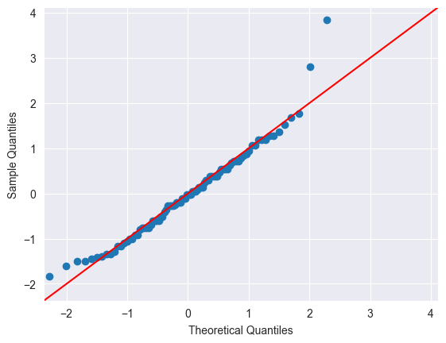
Recruitment Rate
Komolgorov-Smirnov Test (𝛼 = 0.05):
Statistic = 0.9260
p-value = 6.23
The data is normal based on the histogram distribution and Q-Q plots and rejecting the null hypothesis in the K-S test.
However, data is right-skewed.

Slide 19

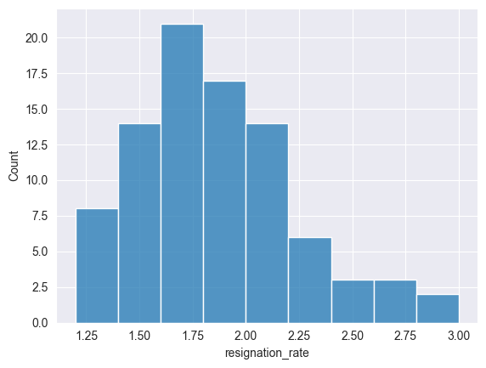
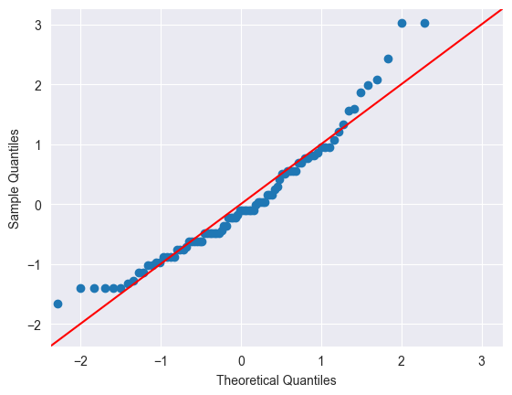
Resignation Rate
Komolgorov-Smirnov Test (𝛼 = 0.05):
Statistic = 0.8918
p-value = 2.09
The data is normal based on the histogram distribution and Q-Q plots and rejecting the null hypothesis in the K-S test.
However, data is right-skewed.

Slide 20
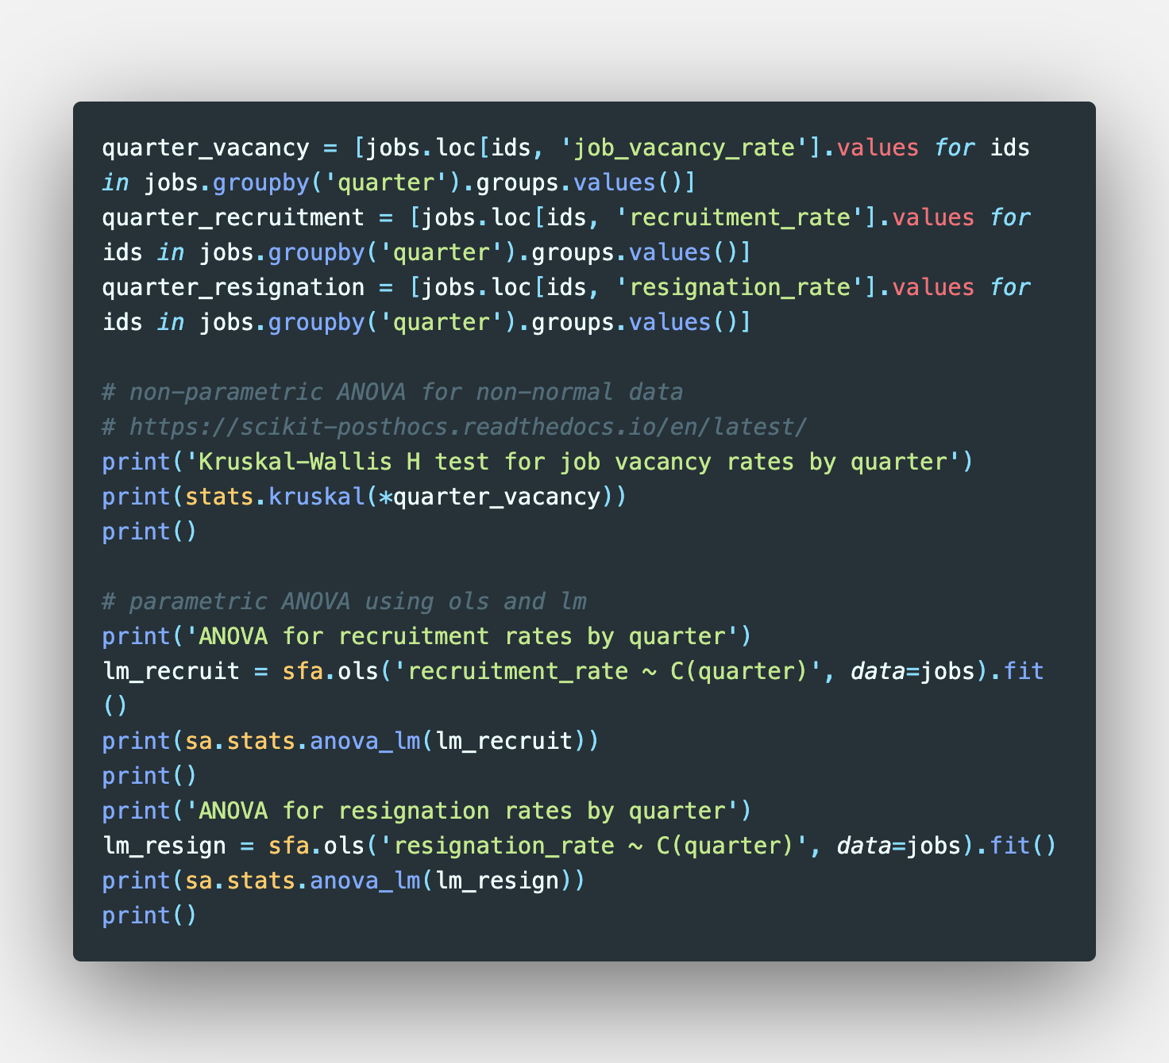
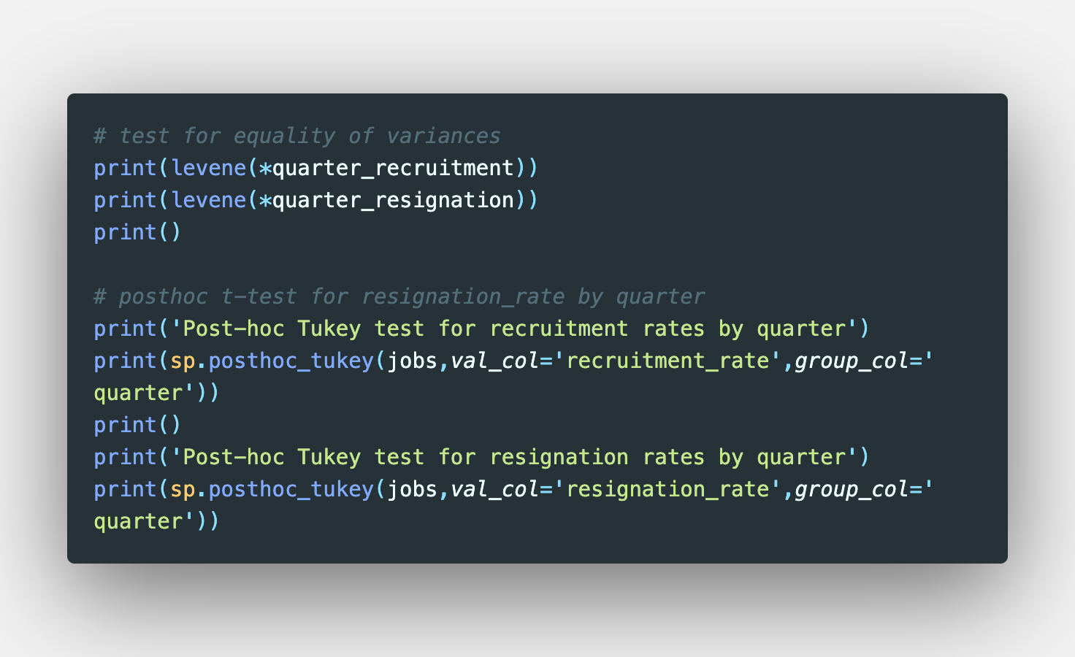
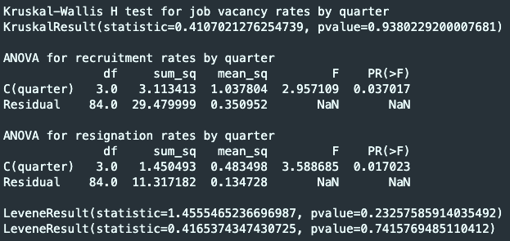
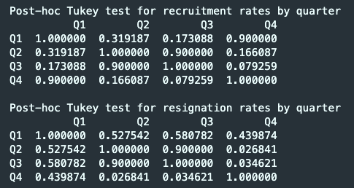
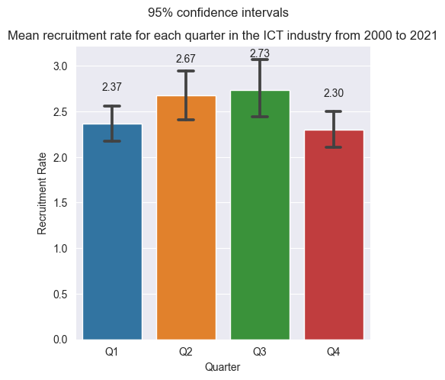
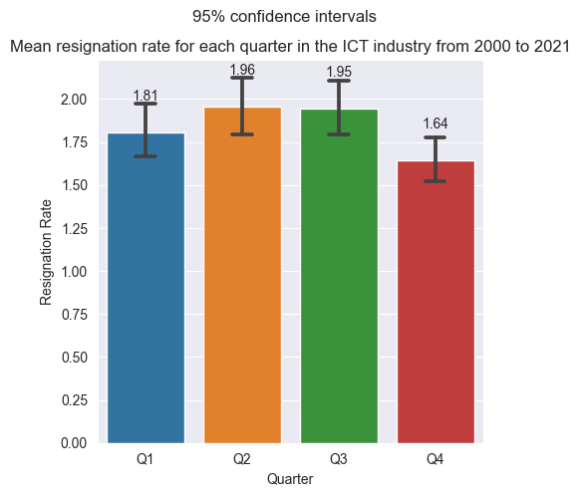
ANOVA tests for quarterly averages of job vacancy, recruitment and resignation rates

Slide 21
ANOVA tests for quarterly averages of job vacancy, recruitment and resignation rates

Slide 22
ANOVA tests for quarterly averages of job vacancy, recruitment and resignation rates

Slide 23
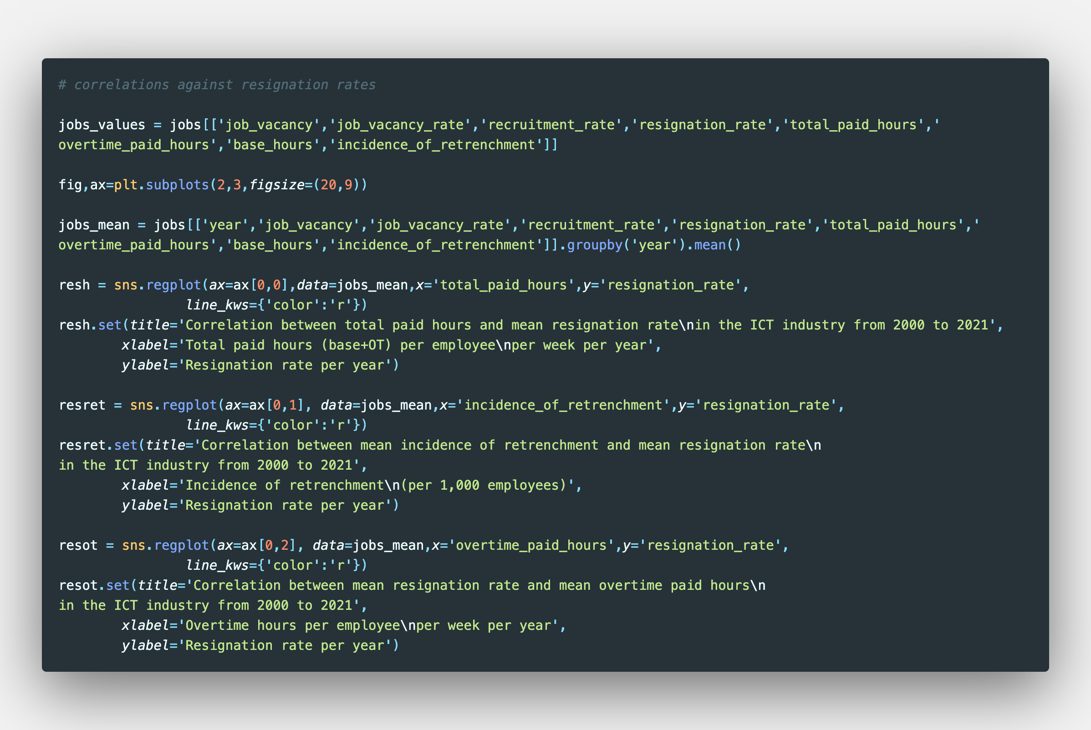
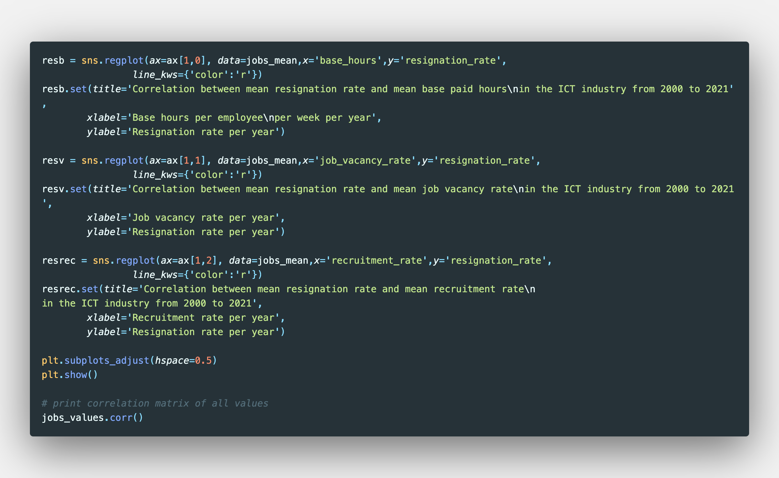
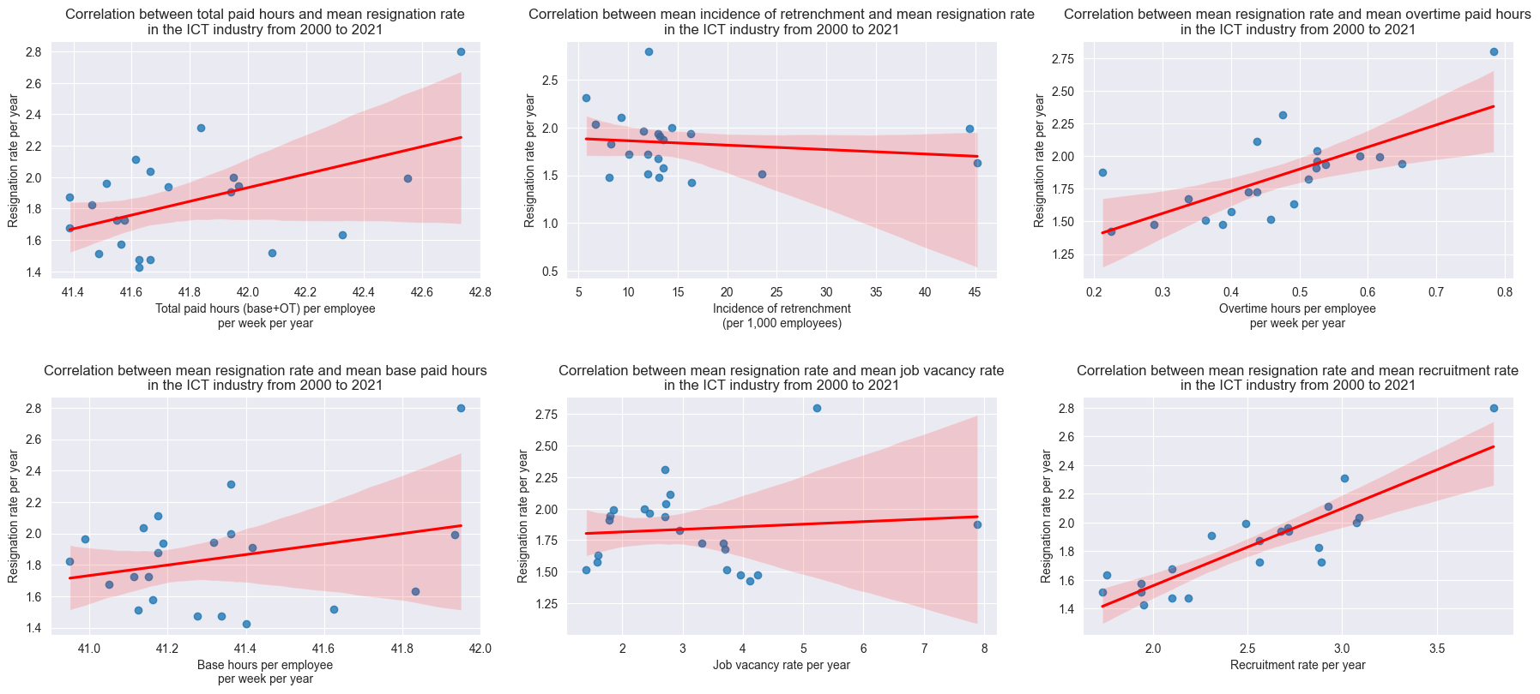
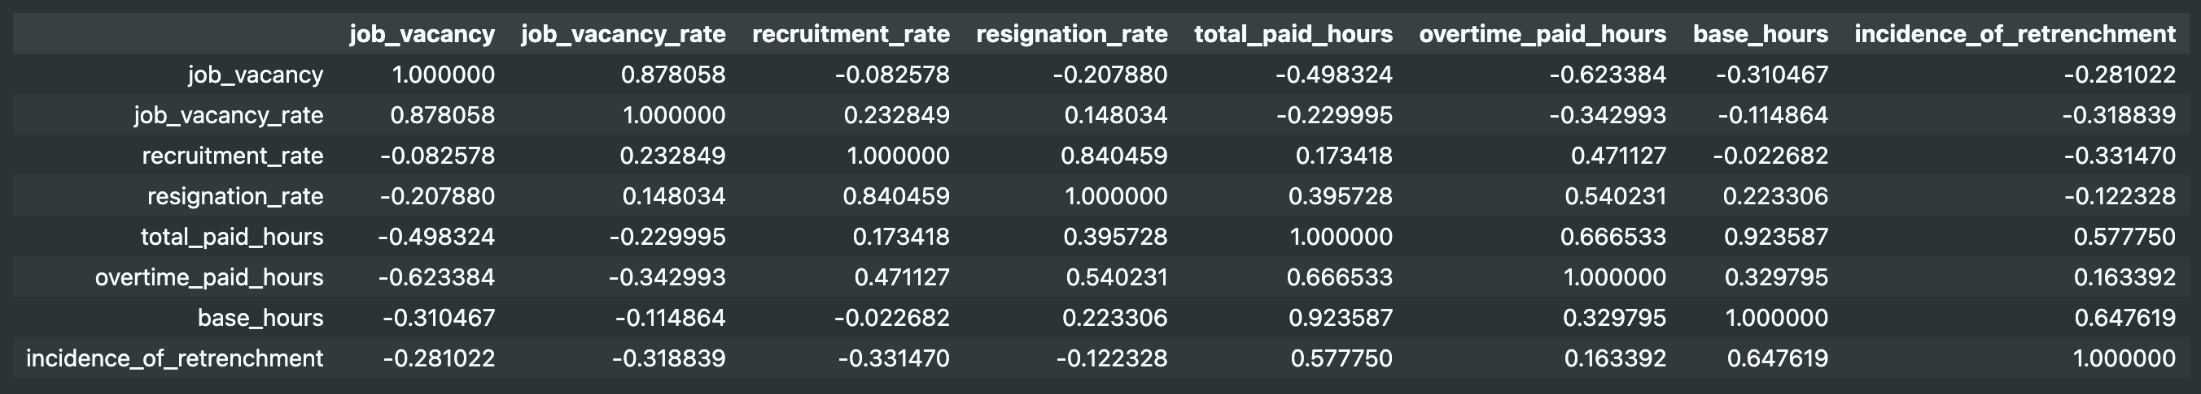
Correlation of variables with resignation rates

Slide 24
Correlation of variables with resignation rates

Slide 25
Correlation of variables with resignation rates

Slide 26
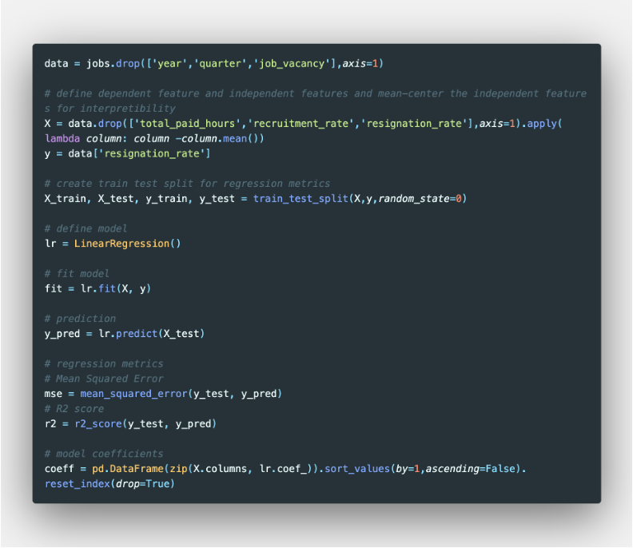
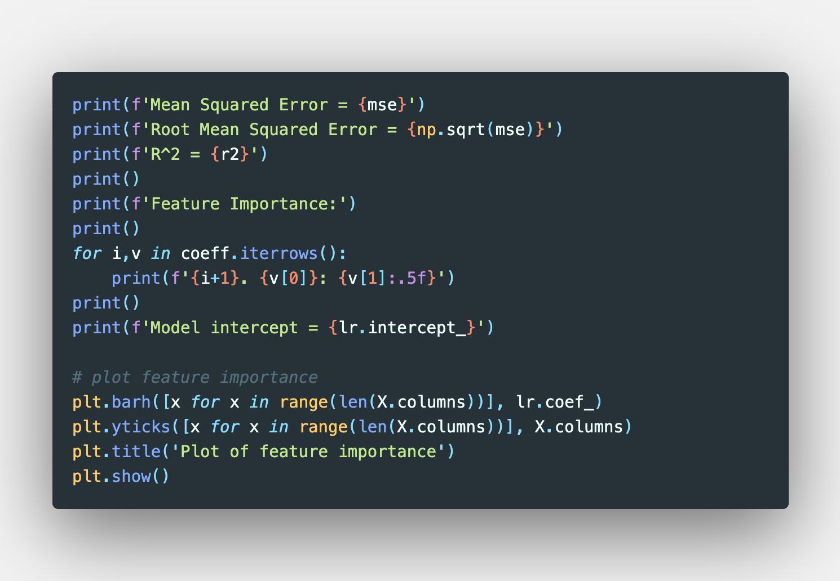
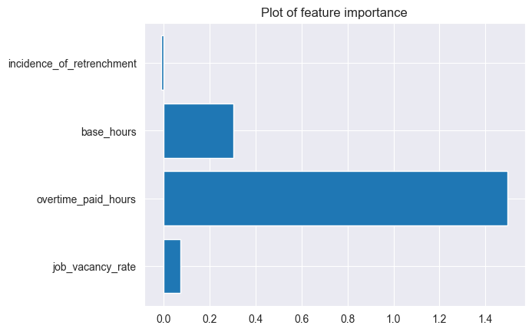
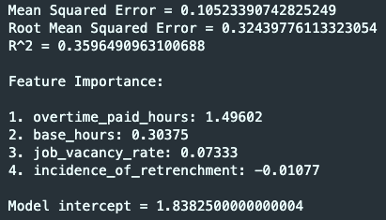
Predicting resignation rates
Features:
Incidence of Retrenchment
Base paid hours
Overtime paid hours
Job Vacancy Rates
Recruitment Rates were excluded due to high correlation with Resignation Rates

Slide 27
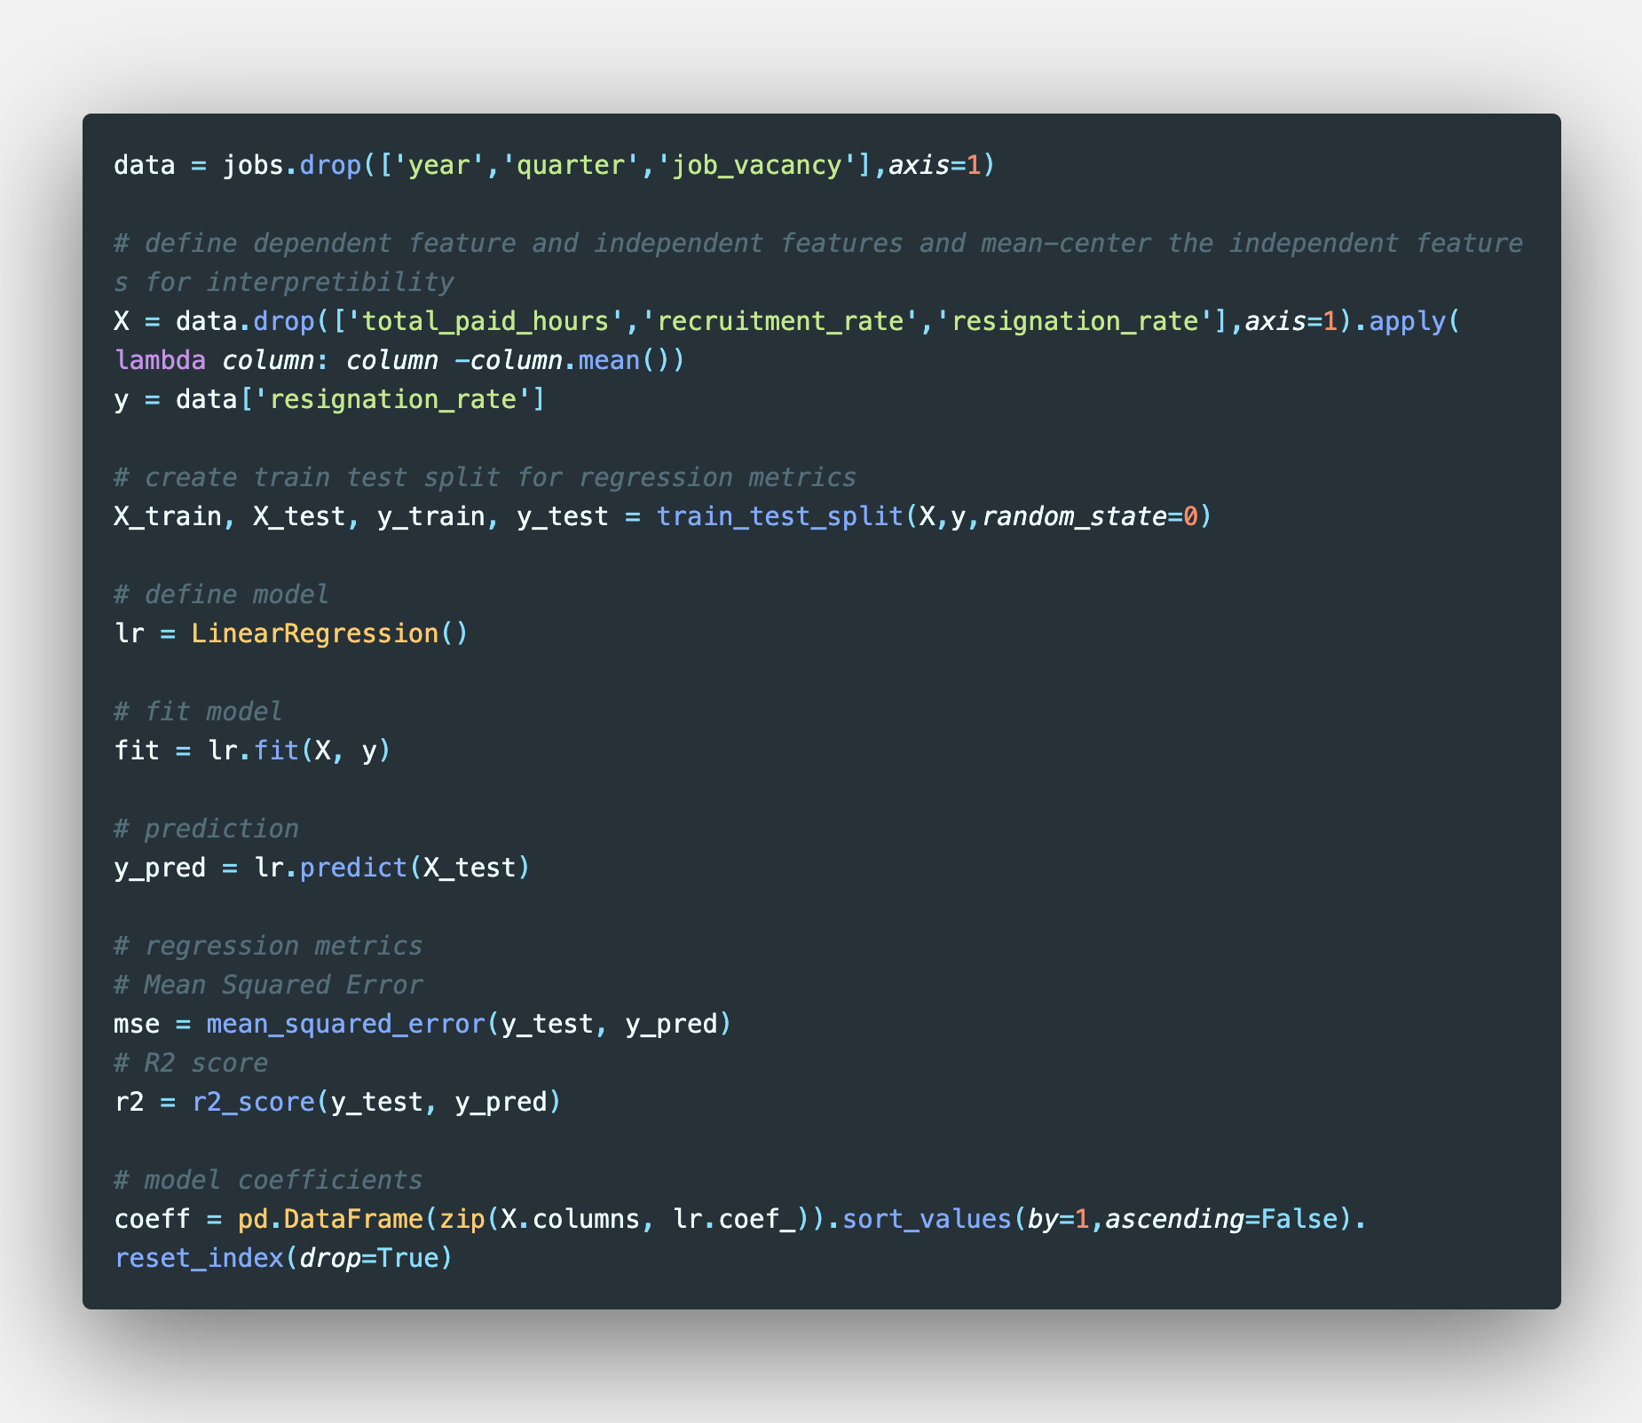
Predicting resignation rates

Slide 28
Predicting resignation rates

Slide 29
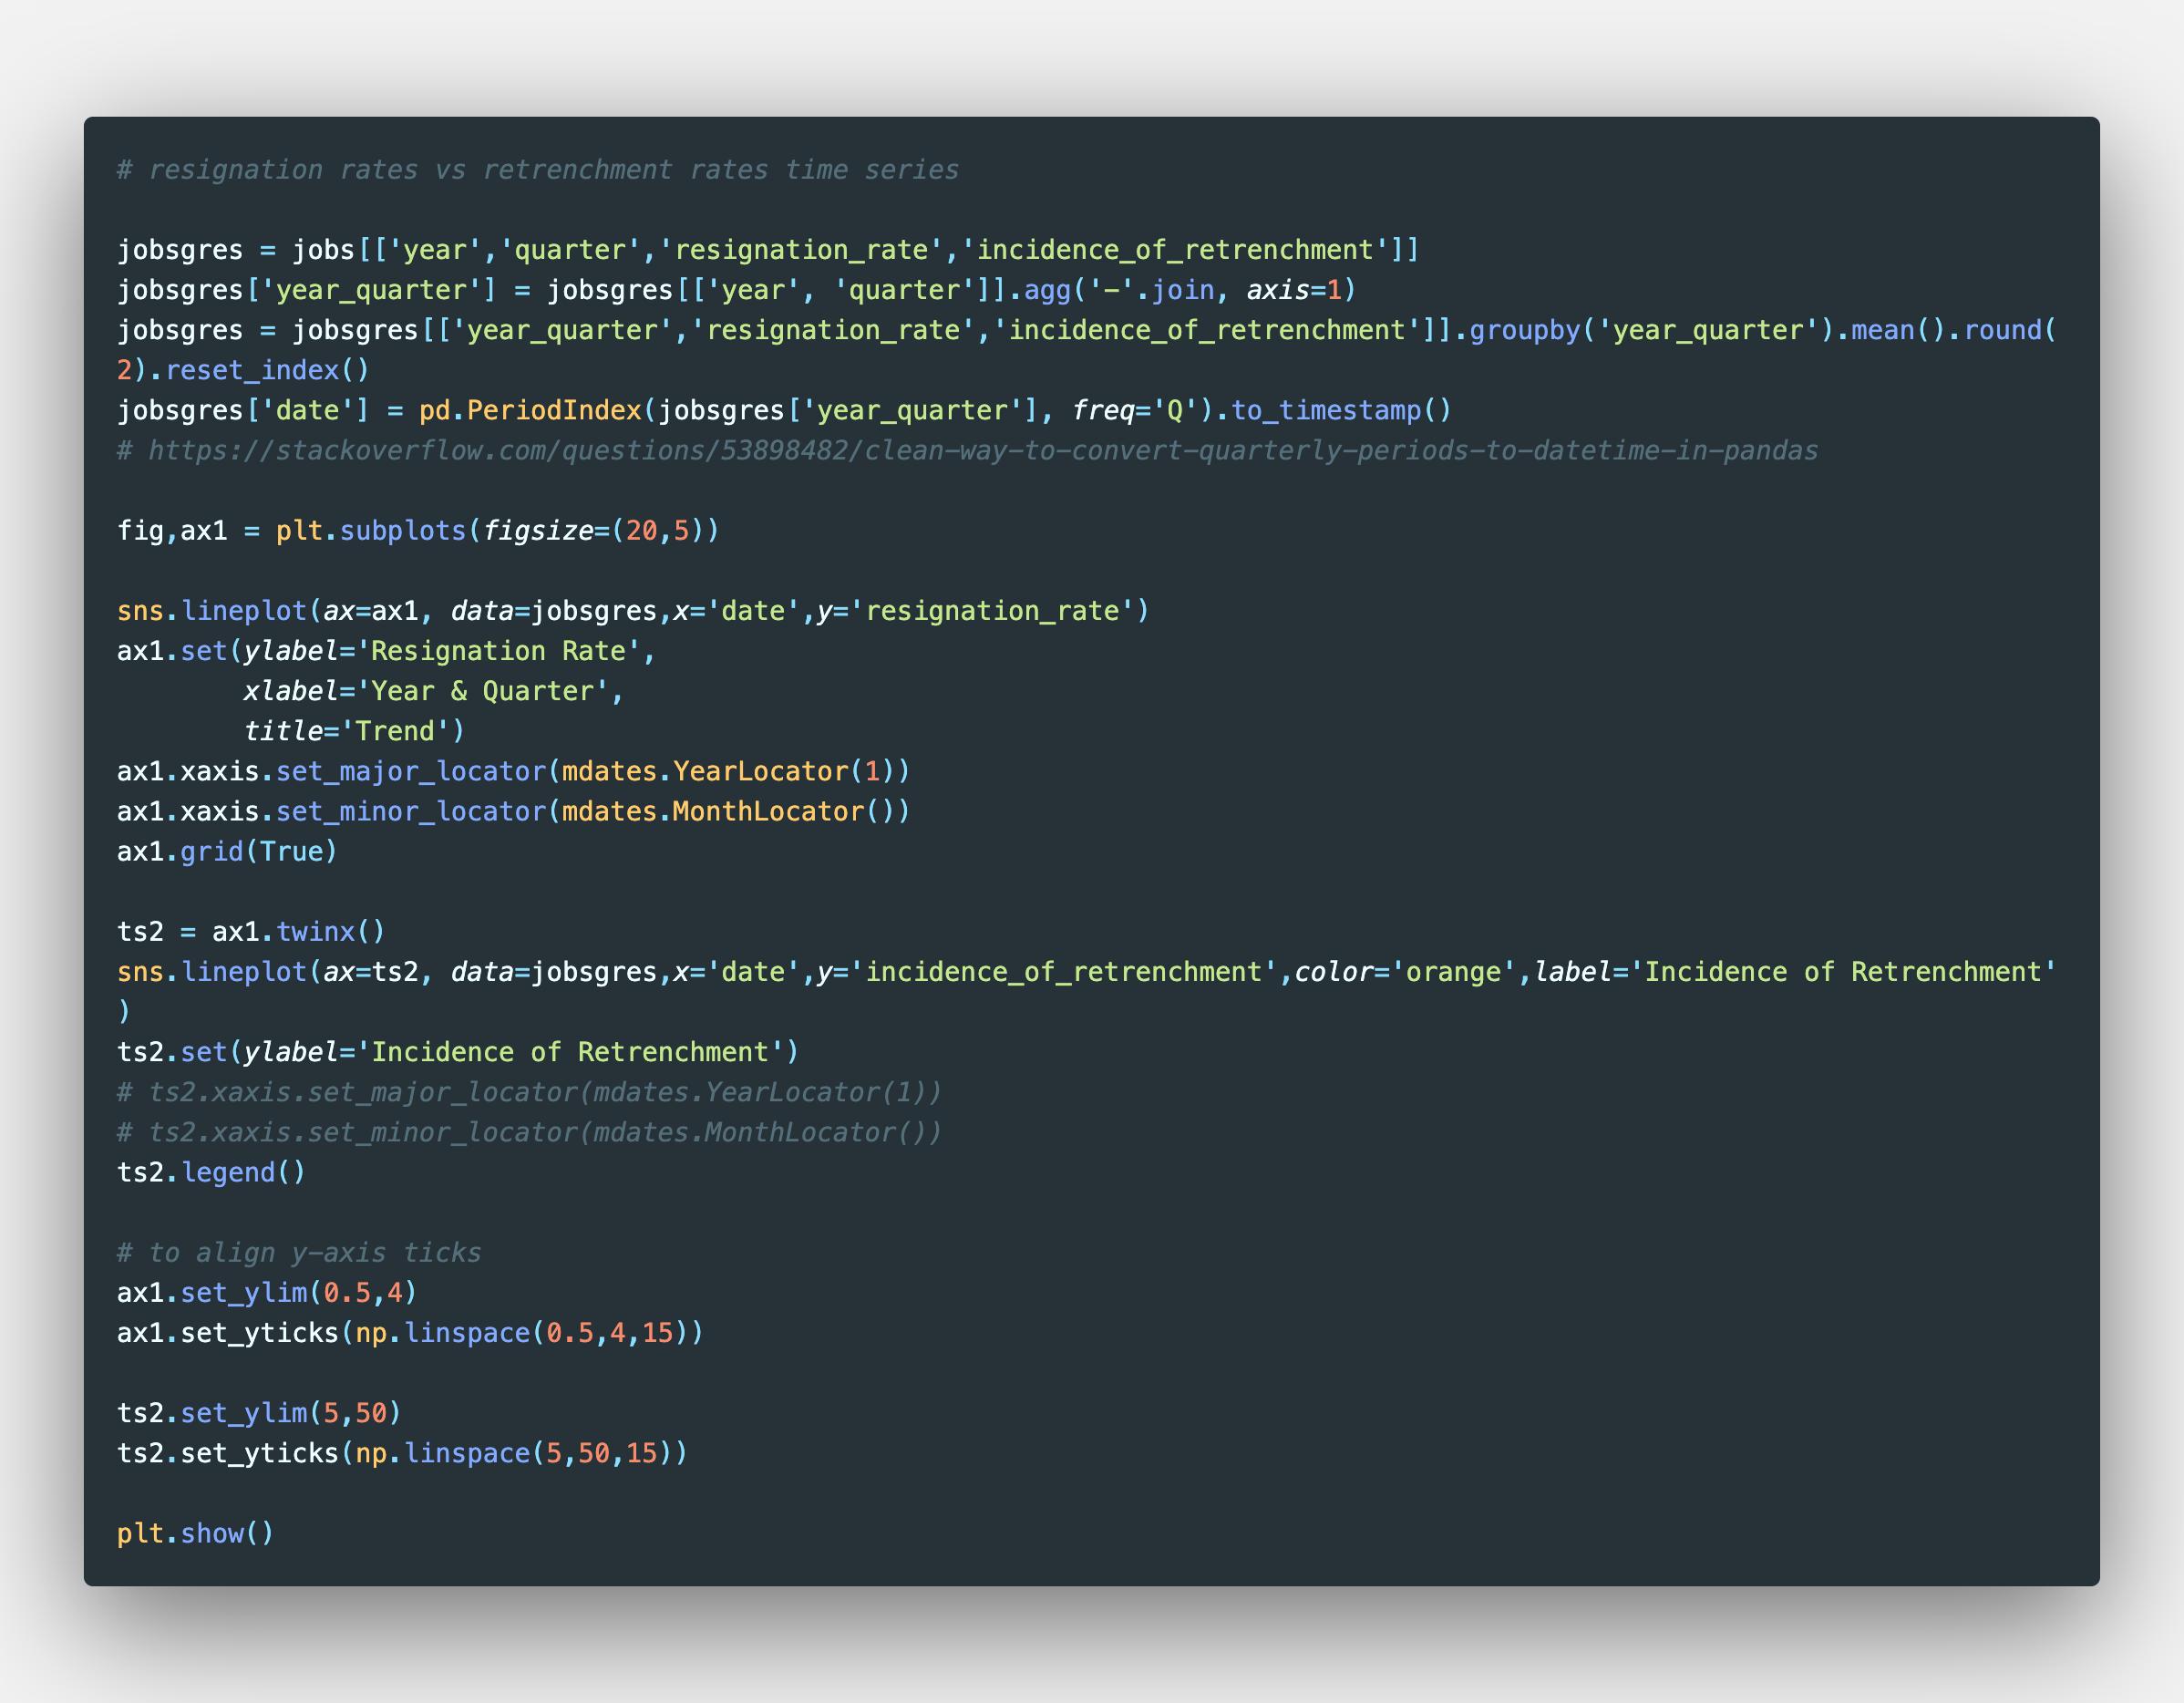
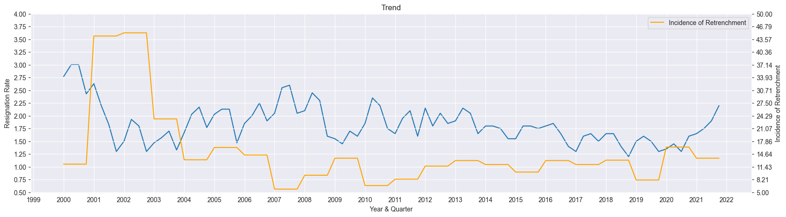
Time series analysis of Incidence of Retrenchment and Resignation Rates

Slide 30
Time series analysis of Incidence of Retrenchment and Resignation Rates

Slide 31
Takeaways
Incidence of retrenchment followed cyclical economic patterns of recession
Most recruitment and resignations, on average, occurred within Q2 and Q3 for the years of 2000 to 2022
This is expected as companies would naturally recruit to fill roles that employees resigned from
Resignation rate had near zero correlation with incidence of retrenchment
Incidence of retrenchment was also a very poor predictor of resignation rates compared to overtime paid hours and base paid hours
The linear regression model fitted was poor (R² = 0.36), which meant that the features only predicted about 36% of the dependent variable.
There could be other features that could add to the predictability of the model, namely psychological features of employee satisfaction and retention (e.g., Human Needs Psychology)

Slide 32
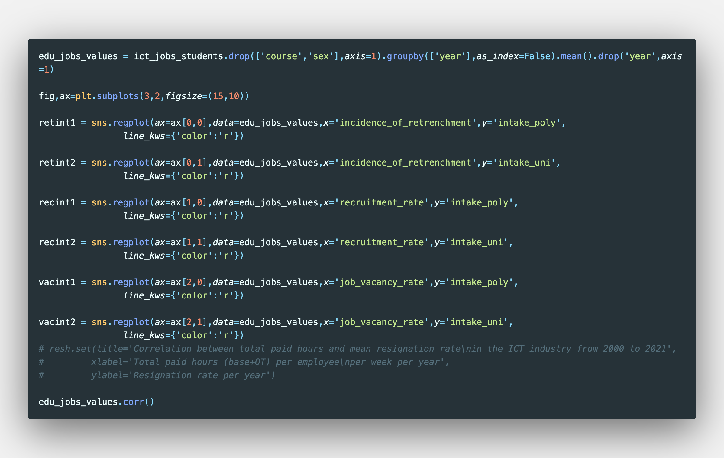
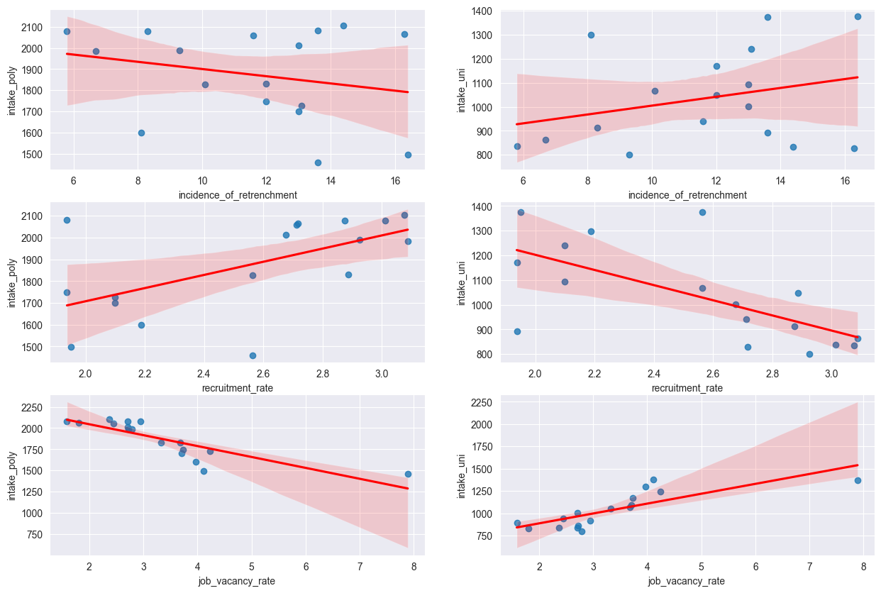
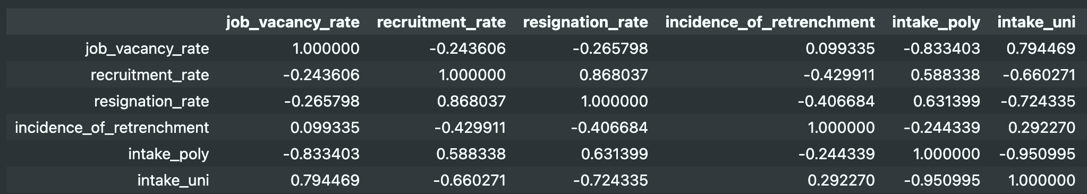
Correlation of variables with polytechnic and university intakes for ICT-related courses

Slide 33
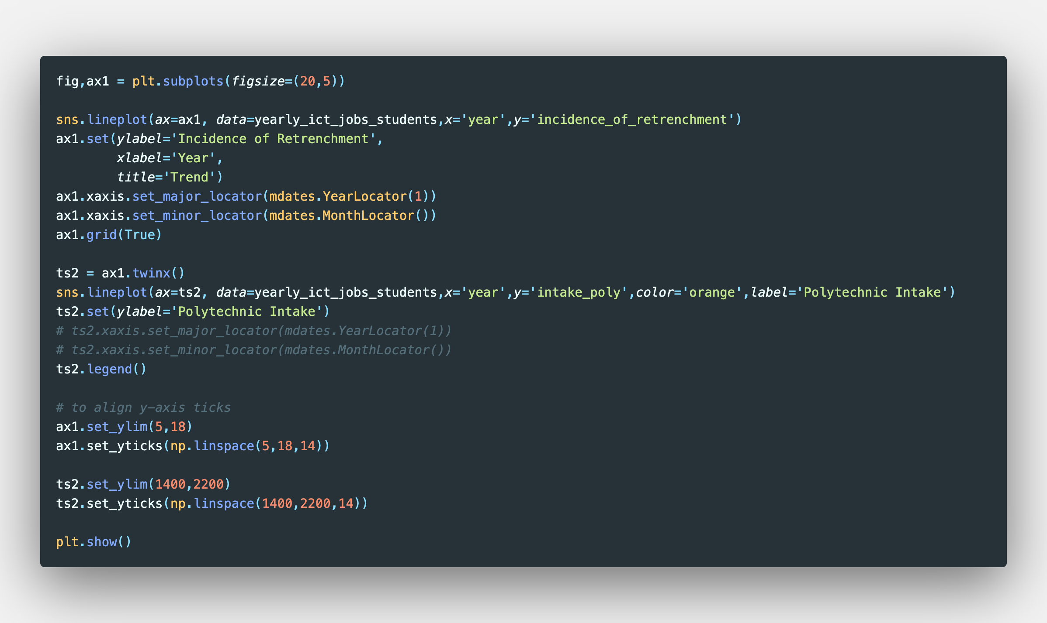

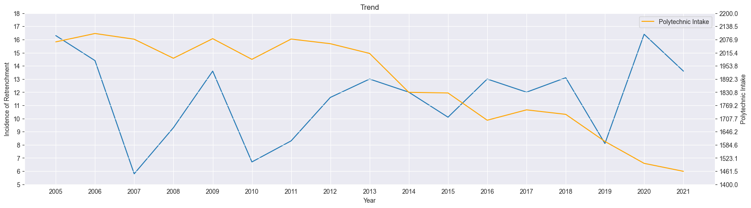
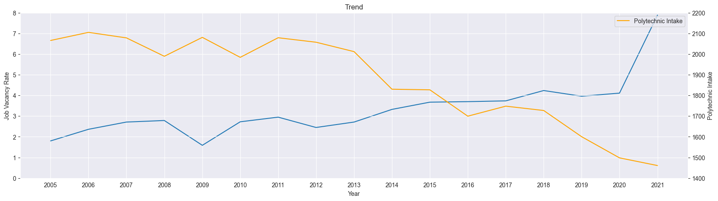
Time series analysis of polytechnic and university intakes for ICT-related courses

Slide 34
Time series analysis of polytechnic and university intakes for ICT-related courses

Slide 35


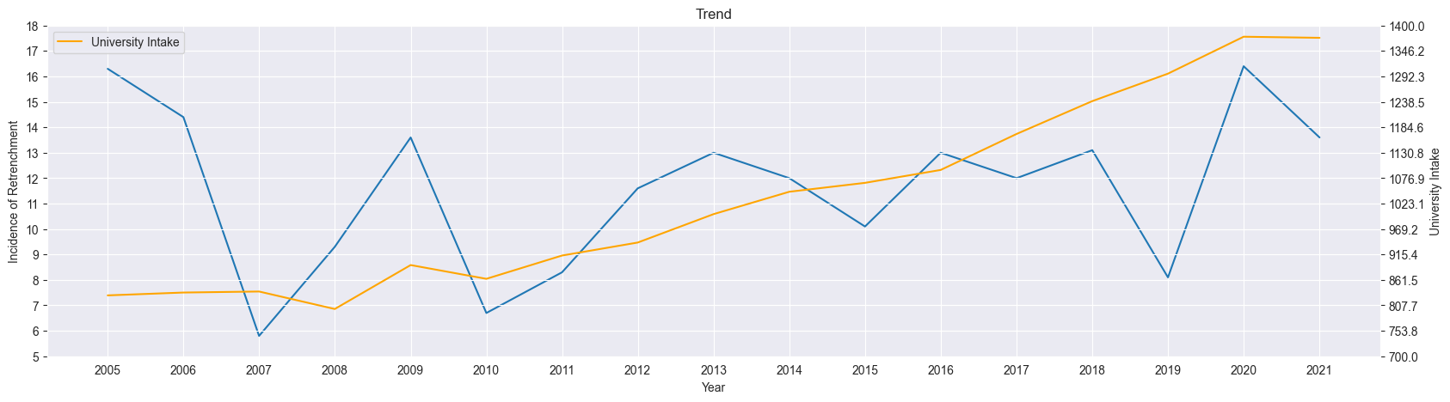
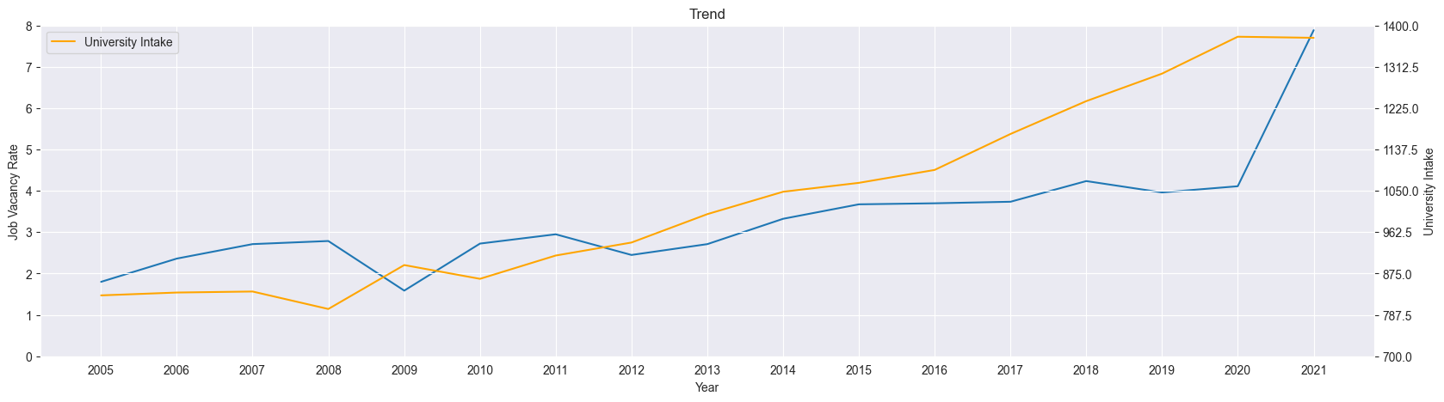
Time series analysis of polytechnic and university intakes for ICT-related courses

Slide 36
Time series analysis of polytechnic and university intakes for ICT-related courses

Slide 37
Takeaways
Correlations between jobs data and higher education intakes should be considered with caveats as different levels of education have different considerations for intake numbers
The data suggests that polytechnic intakes for ICT-related courses are moderately positively correlated with recruitment and resignation rates, which seem to be contradictory
The data also suggests that university intakes for ICT-related courses are strongly positively correlated with job vacancy rates, which could indicate that universities take notice of industry job demands as one of the factors influencing intake rates

Slide 38
Takeaways
Regardless of job vacancy rates and incidence of retrenchment in the ICT industry:
On average across years, polytechnic intake for ICT-related courses appear to be on a downward trend.
With the majority of students in Singapore polytechnics being Singaporeans or Permanent Residents, this trend could be due to falling birth rates and thus smaller cohort sizes
On average across years, university intake for ICT-related courses appear to be on an upward trend.
As Singapore university students are more diverse in nationality, the trend could be due to the sustained high rankings of Singapore universities attracting potential students from beyond Singapore, thus moderating the cohort effect of local falling birth rates
Further analyses is necessary to determine the strength and actual impact of this hypothesised effect

Slide 39
Recommendations
Job seekers in the ICT industry may find more success in Q2 and Q3 as most companies appear to recruit more during this period due to relatively higher resignation rates, among other factors, than in other quarters
ICT companies should not be too concerned about increased resignation rates due to incidence of retrenchment as it does not seem to predict resignation rates as much as other factors like hours worked and possibly even job satisfaction (hypothesised and requires further analysis)
Employees should readily expect higher incidences of retrenchment during periods of recession, as seen in 2022 where the economy was going into a recession
Higher education intakes for ICT-related courses might be somewhat correlated with jobs data, but these should be taken with strong caveats if considering them as indicators of industry demand.

